Slide 1
Multi Dimensional Direct Search Methods
by
Dr. Md. Rajibul Islam
CSE, UAP

Slide 2
Multi Dimensional Direct Search Methods Method-Overview
Obvious approach is to enumerate all possible solutions and find the min or the max.
  Very generally applicable but computationally complex
Direct search methods are open
A good initial estimate of the solution is required
The objective function need not be differentiable

Slide 3
Coordinate Cycling Method
Starts from an initial point and looks for an optimal solution along each coordinate direction iteratively.
For a function with two independent variables x and y, starting at an initial point (x₀,y₀), the first iteration will first move along direction (1, 0) until an optimal solution is found for the function .
The next search involves searching along the direction (0,1) to determine the optimal value for the function.
Once searches in all directions are completed, the process is repeated in the next iteration and iterations continue until convergence occurs.
The search along each coordinate direction can be conducted using anyone of the one-dimensional search techniques previously covered.

Slide 4
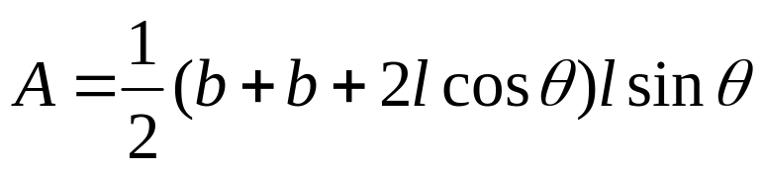
Example
.
l
l
θ
b
θ
The cross-sectional area A of a gutter with base length b and edge length of l is given by
Assuming that the width of material to be bent into the gutter shape is 6, find the angle θ and edge length l which maximizes the cross-sectional area of the gutter.

Slide 5



Solution
Recognizing that the base length b can be expressed as , we can re-write the area function as
Use as the initial estimate of the solution and use Golden Search method to determine optimal solution in each dimension.
To use the golden search method we will use 0 and 3 as the lower and upper bounds for the search region

Slide 6
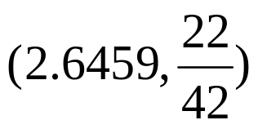
Solution Cont.
Iteration 1 along (1,0)
Iteration | x_{l} | x_{u} | x₁ | x₂ | f(x₁) | f(x₂) | ε
1 | 0.0000 | 3.0000 | 1.8541 | 1.1459 | 3.6143 | 2.6941 | 3.0000
2 | 1.1459 | 3.0000 | 2.2918 | 1.8541 | 3.8985 | 3.6143 | 1.8541
3 | 1.8541 | 3.0000 | 2.5623 | 2.2918 | 3.9655 | 3.8985 | 1.1459
4 | 2.2918 | 3.0000 | 2.7295 | 2.5623 | 3.9654 | 3.9655 | 0.7082
5 | 2.2918 | 2.7295 | 2.5623 | 2.4590 | 3.9655 | 3.9497 | 0.4377
6 | 2.4590 | 2.7295 | 2.6262 | 2.5623 | 3.9692 | 3.9655 | 0.2705
7 | 2.5623 | 2.7295 | 2.6656 | 2.6262 | 3.9692 | 3.9692 | 0.1672
8 | 2.5623 | 2.6656 | 2.6262 | 2.6018 | 3.9692 | 3.9683 | 0.1033
9 | 2.6018 | 2.6656 | 2.6412 | 2.6262 | 3.9694 | 3.9692 | 0.0639
10 | 2.6262 | 2.6656 | 2.6506 | 2.6412 | 3.9694 | 3.9694 | 0.0395
The maximum area of 3.6964 is obtained at point

Slide 7

Solution Cont.
Iteration 1 along (0,1)
Iteration | x_{l} | x_{u} | x₁ | x₂ | f(x₁) | f(x₂) | ε
1 | 0.0000 | 1.5714 | 0.9712 | 0.6002 | 4.8084 | 4.3215 | 1.5714
2 | 0.6002 | 1.5714 | 1.2005 | 0.9712 | 4.1088 | 4.8084 | 0.9712
3 | 0.6002 | 1.2005 | 0.9712 | 0.8295 | 4.8084 | 4.8689 | 0.6002
4 | 0.6002 | 0.9712 | 0.8295 | 0.7419 | 4.8689 | 4.7533 | 0.3710
5 | 0.7419 | 0.9712 | 0.8836 | 0.8295 | 4.8816 | 4.8689 | 0.2293
6 | 0.8295 | 0.9712 | 0.9171 | 0.8836 | 4.8672 | 4.8816 | 0.1417
7 | 0.8295 | 0.9171 | 0.8836 | 0.8630 | 4.8816 | 4.8820 | 0.0876
8 | 0.8295 | 0.8836 | 0.8630 | 0.8502 | 4.8820 | 4.8790 | 0.0541
9 | 0.8502 | 0.8836 | 0.8708 | 0.8630 | 4.8826 | 4.8820 | 0.0334
The maximum area of 4.8823 is obtained at point

Slide 8
Solution Cont.
Since this is a two-dimensional search problem, the two searches along the two dimensions completes the first iteration.
In the next iteration we return to the first dimension for which we conducted a search and start the second iteration with a search along this dimension.
After the fifth cycle, the optimal solution of (2.0016, 10420) with an area of 5.1960 is obtained.
The optimal solution to the problem is exactly 60 degrees which is 1.0472 radians and an edge and base length of 2 inches. The area of the gutter at this point is 5.1962.

Slide 9
THE END

